Slide 1
FHIR Overview CCIM
Lloyd McKenzie
Apr. 16, 2018

Slide 2
This presentation
Is licensed for use under the Creative Commons, specifically:
Creative Commons Attribution 3.0 Unported License
(Do with it as you wish, so long as you give credit)

Slide 3

Who am I?
Name: Lloyd McKenzie
Company: Gevity
Background:
One of FHIR’s 3 initial editors
Co-chair FMG & FHIR Infrastructure
Co-chair HL7 Modeling & Methodology
Heavily involved in HL7 and healthcare exchange for last 17 years (v2, v3, CDA, etc.)
lmckenzie@gevityinc.com

Slide 4
Presentation Objectives
Today
FHIR operations & error handling
FHIR Profiles & defining an interface
Security & Consent
SMART on FHIR & CDS Hooks
Q&A

Slide 5
Operations & Error Handling

Slide 6
FHIR Resource URLs
Template | Description | Example | Operations
[base] | Server URL | http://fhir.com | GET, POST
[base]/[type] | Collection Manager | http://fhir.com/Patient | GET, POST
[base]/[type]/[id] | URL for a resource | http://fhir.com/Patient /23 | GET, PUT, DELETE, PATCH
[base]/[type]/[id]/_history/[vid] | Past version | http://fhir.com/Patient/23/_history/2 | GET
[base]/([type]/([id]/)?)?$[name] | Operation (server action) | http://fhir.com/Patient /23/$everything | GET, POST
Notes:
URL (http://myhospital.org/) you are invoking in first column, and operations at right
OPTIONS - Return available HTTP methods and other options

Slide 7
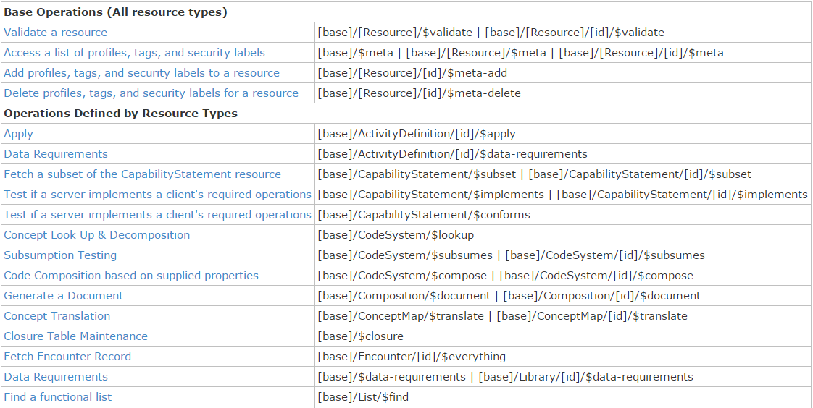
Example operations
Notes:
Operations are an “extension” to the RESTful framework

Slide 8
Lets try some
http://fhirtest.uhn.ca/
(Find other servers at http://wiki.hl7.org/index.php?title=Publicly_Available_FHIR_Servers_for_testing)

Slide 9
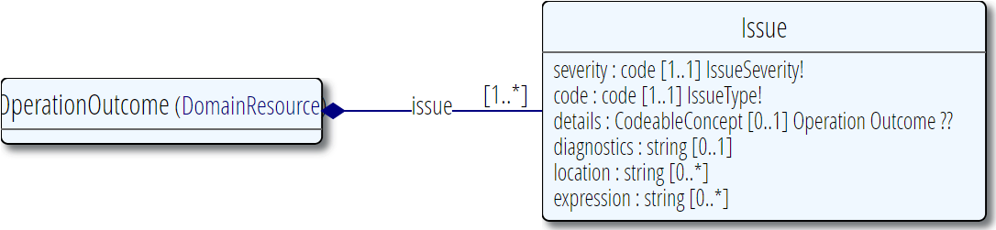
Error handling
HTTP- based errors
400, 404, 500, etc.
OperationOutcome

Slide 10
Profiles

Slide 11
Profile-less FHIR
You don’t need profiles to interoperate with FHIR
Resources are “discrete” enough that mechanism to populate most elements is clear
Approach
Populate/consume all elements you know, use HL7 or country-standard extensions for extras
Map to/from “recommended” terminologies as much as possible, populate CodeableConcept.text
Expose capabilities in CapabilityStatement resource
Notes:
With profile, they can interoperate ‘ok’.

Slide 12
Profile Uses
Profiles are still quite useful
Define document and message boundaries
Define extensions
Set interoperability expectations in a particular context
National standards, types of care, business patterns
Clinical practice guidelines / detailed clinical models
Document system capabilities

Slide 13
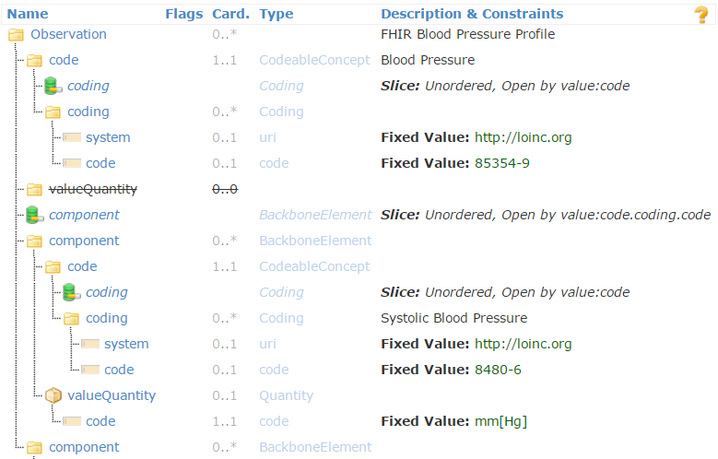
Profiled Observation (Blood Pressure)

Slide 14
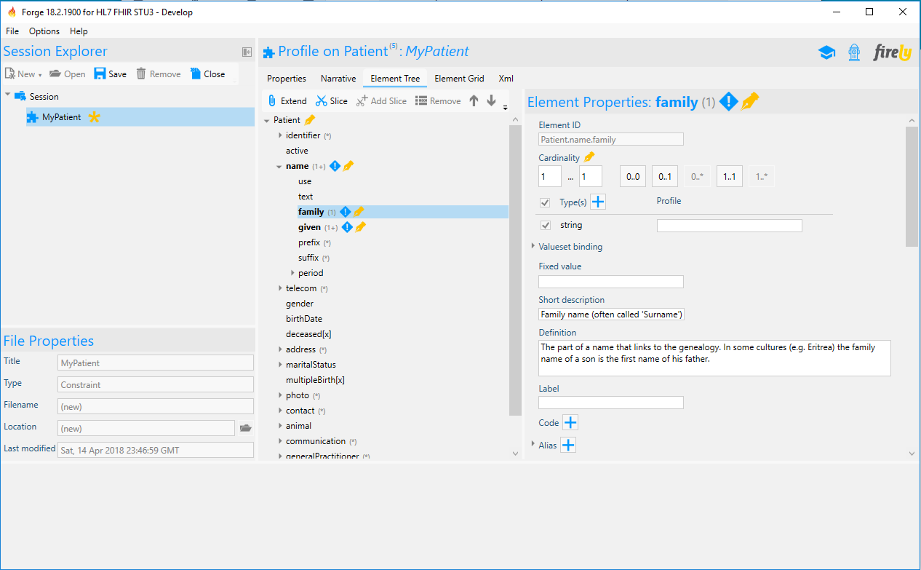
Forge

Slide 15
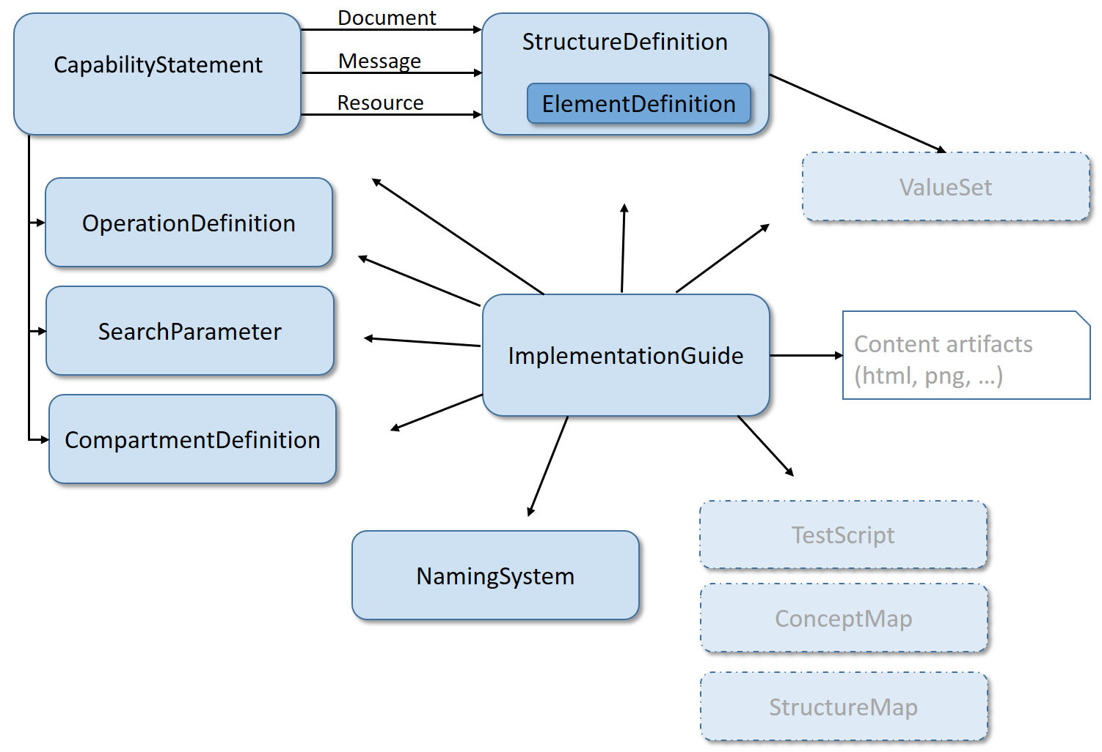
Defining an Interface

Slide 16
Implementation Guides
https://www.ehealthontario.on.ca/images/uploads/standards_docs/FHIR-PCR-Specification/site/index.html
http://hl7.org/fhir/us/sdc/
https://www.prescribeit.ca/

Slide 17
Official HL7 FHIR registries
HL7 FHIR Profile registry
https://registry.fhir.org/
Find official profiles published by HL7 intl. & WGs
HL7 FHIR Implementation Guide registry
http://www.fhir.org/guides/registry
Browse official HL7 implementation guides
Canadian FHIR registry
https://simplifier.net/ui/Organization/CanadianFHIRRegistry

Slide 18
Security & Consent

Slide 19
FHIR Security
Framework with options/guidance
http://hl7.org/fhir/security.html
Covers:
Communications (e.g. TLS/SSL)
Authentication (e.g. OAuth)
Authorization/Access Control
Audit (AuditEvent resource)
Digital Signatures
Other considerations
What applies varies by environment

Slide 20
Consent & Privacy
Consent resource
Exposes consent for exchange purposes
Security Labels
Allow marking a resource as subject to a particular security policy/constraint
FHIR doesn’t establish standard security policies
Implementers must negotiate those themselves

Slide 21
Building on FHIR

Slide 22



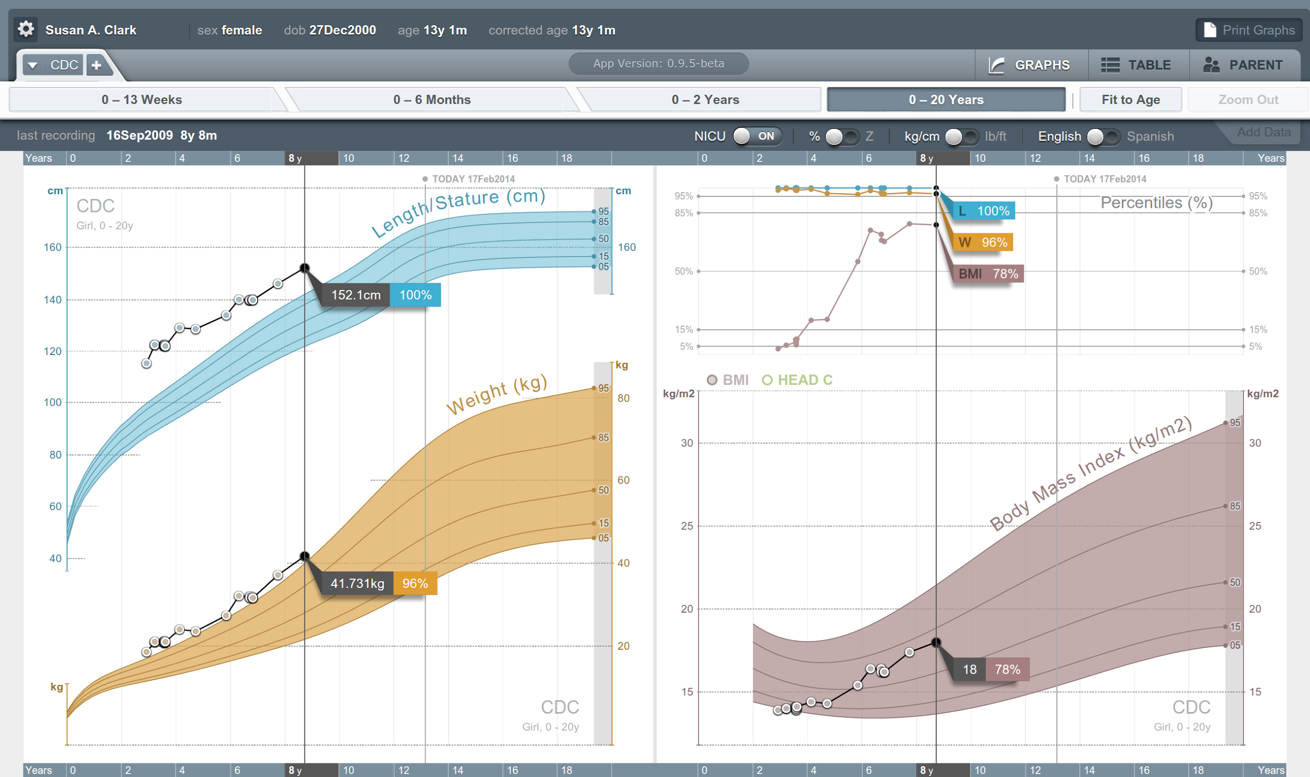


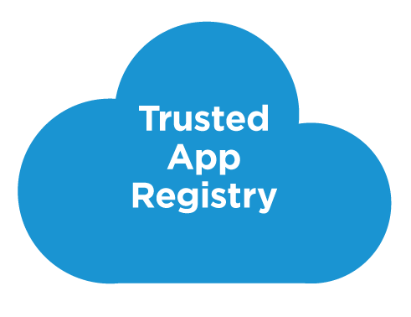



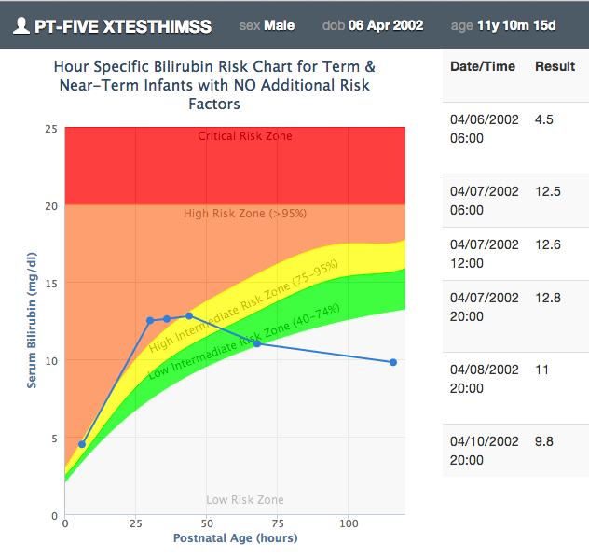







SMART on FHIR
Mobile Apps
Web Apps
OAuth2
REST API
MU-oriented FHIR Data Profiles
Underlying Health IT Systems
Your system here.

Slide 23
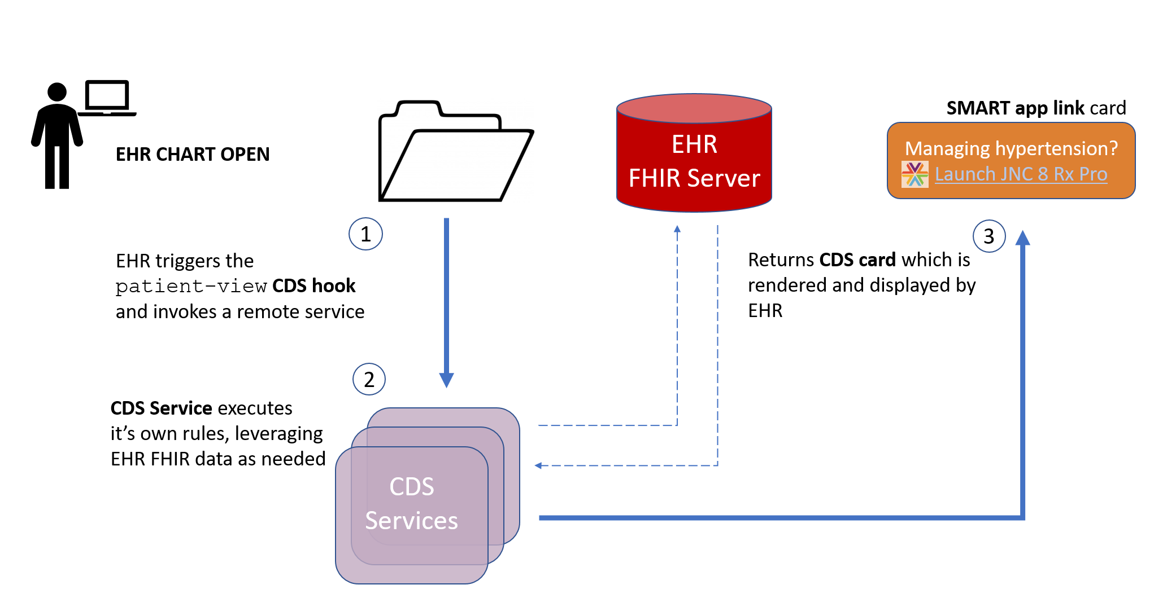
CDS Hooks

Slide 24


Questions?
http://hl7.org/fhir lmckenzie@gevityinc.com

